Slide 1
Software Engineering Code of Ethics and Professional Practice
Prepared by:
Md. Aquib Azmain
Lecturer Department of Computer Science & Engineering BRAC University.
9-‹#›

Slide 2
Outline
Introduction.
Need of Software Ethics
The ACM Code of Ethics
The IEEE Code of Ethics
The Impact of Unethical Practices
Ethical Decision-Making Models
9-‹#›

Slide 3
INTRODUCTION
Ethics in software engineering is about making decisions that respect user privacy, promote fairness, and benefit society.
It involves -
Adhering to professional codes,
Navigating ethical dilemmas, and
Understanding the impact of unethical practices.
9-‹#›

Slide 4
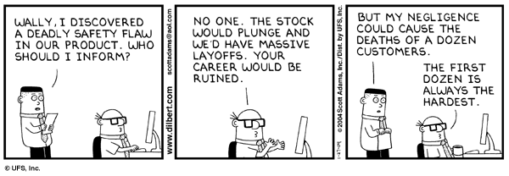
Need of Software Ethics
9-‹#›

Slide 5
(cont’d)
The quality of software is critical to the society.
Lives depend on the safety and reliability of many software systems (control of air traffic, nuclear power stations etc).
The quality of software product depends on the ethics and professional conduct of the engineers.
9-‹#›

Slide 6
The ACM Code of Ethics
This code, developed by the Association for Computing Machinery (ACM), serves as a roadmap for making decisions that are ethically responsible and professionally sound.
9-‹#›

Slide 7
The ACM Code of Ethics : Moral Imperatives
Contribute to society and human well-being
Avoid harm to others
Be honest and trustworthy
9-‹#›
Notes:
Contribute to society and human well-being: This principle emphasizes the positive impact that software engineering can have on society and individuals. It encourages engineers to use their skills for the benefit of humanity.
Avoid harm to others: Harm can come in many forms, such as physical harm, mental harm, or harm to data and systems. Software engineers should strive to minimize harm caused by their actions or the software they create.
Be honest and trustworthy: Honesty is a fundamental aspect of ethics. Software engineers should be truthful about their qualifications, capabilities, and the potential impact of their work.

Slide 8
The ACM Code of Ethics : Professional Responsibilities
Strive for excellence
Maintain confidentiality
Respect intellectual property
9-‹#›
Notes:
Strive for excellence: Software engineers should always aim to produce high-quality work and continuously improve their skills and knowledge.
Maintain confidentiality: Engineers should respect the privacy of their clients and users, and protect any sensitive information they handle.
Respect intellectual property: This includes recognizing and crediting the work of others, and avoiding plagiarism and unauthorized use of software.

Slide 9
The ACM Code of Ethics : Professional Leadership Principles
Lead by example
Promote public knowledge
Mentor younger professionals
9-‹#›
Notes:
Lead by example: Leaders should model ethical behavior and promote a culture of ethical decision-making within their teams.
Promote public knowledge: Leaders should strive to increase public understanding of software engineering, its achievements, and its challenges.
Mentor younger professionals: Experienced engineers have a responsibility to guide and mentor those who are new to the field.

Slide 10
The IEEE Code of Ethics
The Institute of Electrical and Electronics Engineers (IEEE) has developed this code. Total Eight Principles:
Public
Product
Judgment
Client and Employer
Management
Profession
Colleagues
Self
9-‹#›

Slide 11
The IEEE Code of Ethics: Responsibilities to the Public
Public Safety and Welfare
Environmental Considerations
Public Understanding
9-‹#›
Notes:
Public Safety and Welfare: Software engineers should prioritize the safety and welfare of the public in all their professional activities. This includes creating software that is secure, reliable, and respects user privacy.
Environmental Considerations: Engineers should be aware of the environmental impact of their work and strive to create sustainable and eco-friendly solutions.
Public Understanding: Professionals have a duty to provide accurate information about software systems and their potential impacts, helping to increase public understanding of software engineering.

Slide 12
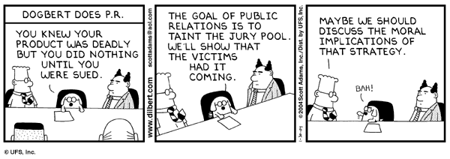
(cont’d)
9-‹#›

Slide 13
The IEEE Code of Ethics: Responsibilities to the Clients and Employers
Confidentiality
Conflict of Interest
Quality Assurance
9-‹#›
Notes:
Confidentiality Software engineers should respect and protect confidential information obtained during their professional activities.
Conflict of Interest Engineers should avoid real or perceived conflicts of interest and disclose them to affected parties when they do occur.
Quality Assurance Professionals should strive to provide high-quality services and products that meet the needs of clients and employers.

Slide 14
The IEEE Code of Ethics: Responsibilities to the Profession
Professional Development
Professional Conduct
Support for Colleagues
9-‹#›
Notes:
Professional Development: Software engineers should engage in lifelong learning to maintain and enhance their professional competence.
Professional Conduct: Engineers should behave in a manner that upholds the integrity and dignity of the profession.
Support for Colleagues: Professionals should support and assist their colleagues in their professional development.

Slide 15
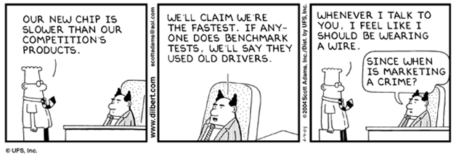
(cont’d)
9-‹#›

Slide 16
The Impact of Unethical Practices
Legal Consequences
Lawsuits, fines, and in some cases, criminal charges.
Collecting user data without proper consent can cause fines under laws like the General Data Protection Regulation (GDPR) in the European Union.
Reputational Damage
Impact on Users and Society
9-‹#›

Slide 17
Solution: Ethical Decision-Making Models
The Consequence-based model: This model focuses on the outcomes of an action and aims to choose the action that results in the most good or least harm.
The Duty-based model: This model emphasizes the inherent duties and obligations of the professional, regardless of the outcome.
The Virtue-based model: This model focuses on the character and virtues of the individual, aiming to choose actions that align with these virtues.
9-‹#›

Slide 18
References
https://www.acm.org/code-of-ethics
https://www.ieee.org/about/corporate/governance/p7-8.html
9-‹#›

